Slide 1
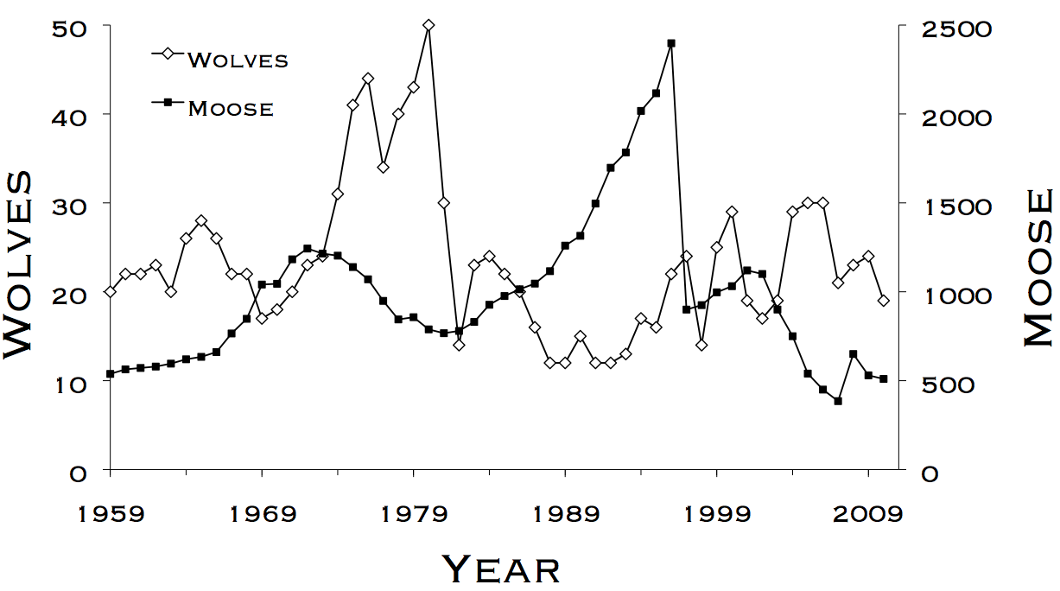
Lab 1 - Setting the Stage
WLE 411, Week 3

Slide 2
Readings and deadlines
Lab preface assignment due at the start of class
Readings for this lab:
Chapter 1- Models
We’ll be using our first model today!
Data organization in spreadsheets
Esp. important for importing data into R

Slide 3
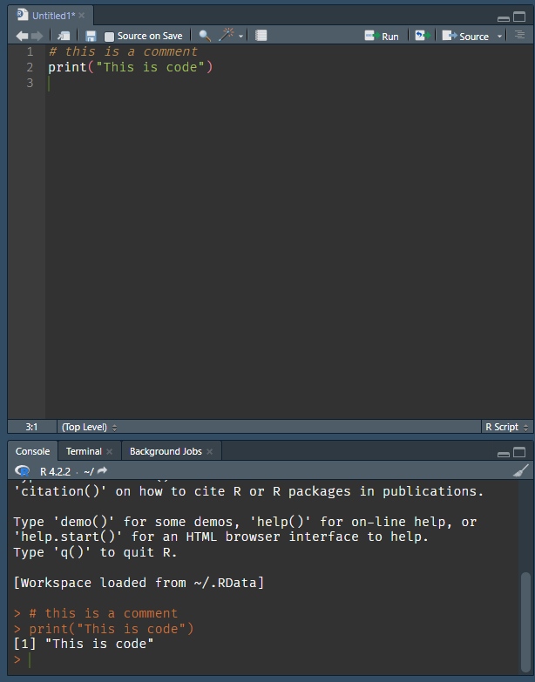

Slide 4

Population estimation using mark-recapture
Parameter to estimate:
N: Total # of animals
Parameters to measure:
M: # of animals marked on first occasion
C: # of animals marked on second occasion
m (blue & red): # of animals marked on both occasions
Notes:
Review from WLE 201

Slide 5
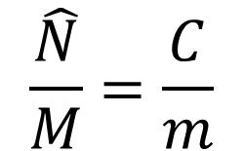
Lincoln-Peterson estimator
$$\frac{\hat{N}}{M}=\frac{C}{m}$$
or
$$\frac{Total \# of animals}{\# of animals marked on first occasion}=\frac{\# of animals marked on second occasion}{\# of animals marked on both occassions}$$

Slide 6
What assumptions do we make?
Population closure
No individuals entering or exiting the population
To avoid violating, both capture sessions should be close together
Equal probability of capture for all individuals
Large sample sizes
If m is too small, then N is biased towards a very large number
Can be corrected using a new formula (Equation 3)

Slide 7
Using Excel

Slide 8
Using Excel

Slide 9
Statistics review
Sample statistics
Sample mean (x̅):
The mean value of observations in the sample
Standard deviation (SD, σ):
The expected difference between individual points and the sample mean
Population statistics
Population mean (μ):
The “true” mean value
e.g. measure the antlers of every deer in the population
Standard error (SE):
The expected difference between the sample and population mean

Slide 10
Statistics review
Population statistics
95% confidence intervals:
An interval which should include the population mean 95% of the time
Lower boundary: x̅ – 1.96*SE
Upper boundary: x̅ + 1.96*SE

Slide 11
Calculating lambda (λ)
Definition:
The discrete growth rate of a population
If λ = 1, population is stable
If λ > 1, population is rising
If λ < 1, population is declining
Calculating λ across multiple years:
Check your lecture slides from Sep. 7th

Slide 12
